Slide 1
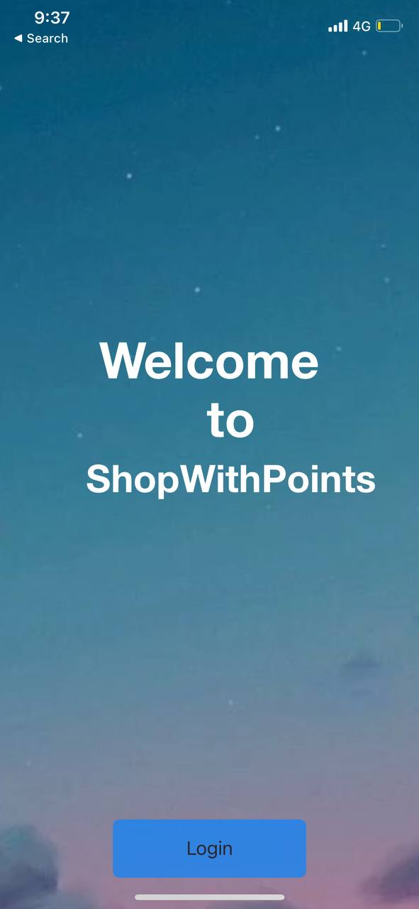
Shop With Points
Alireza Samadifardheris
Ashkan Ansarifard
Notes:
Ashkan

Slide 2


Content
Why Shop With Points?
Wireframe by Balsamiq
Sprints
The Idea
Features
User Stories
Functional Point & COCOMOII
Notes:
Ashkan ( 7 minutes till END OF FP

Slide 3

Content
Docker
References
Technologies
Demo
Notes:
Alireza 5

Slide 4
Why Shop With Points?
Wireframe by Balsamiq
Sprints
The Idea
Features
User Stories
Functional Point & COCOMOII
Notes:
Ashkan

Slide 5
The Idea
User Profiles
Clients will be able to create User Profiles
Your points Wallet
Business Profiles
Businesses will be able to create Business Profiles
Shop and Make reviews
Search shops and go shopping and leave reviews about you experience
$
$
Obtain coins
$
For each of your reviews obtain coins
Use your coins in the shops
Next time you go shopping, use your coins to get discounts and rewards
Notes:
Ashkan

Slide 6
Why Shop With Points?
Wireframe by Balsamiq
Sprints
The Idea
Features
User Stories
Functional Point & COCOMOII
Notes:
Ashkan

Slide 7
Why Shop With Points?
To see your business from users’ point of view
To have a low price but highly intriguing advertisement
Businesses
Shop With Points
Users
To be an incentive for the customers to make a purchase
To motivate customers to leave a proper review
Notes:
Ashkan

Slide 8
Why Shop With Points?
Wireframe by Balsamiq
Sprints
The Idea
Features
User Stories
Functional Point & COCOMOII
Notes:
Ashkan

Slide 9
Features
Businesses
Users
Log in with verified Business Account
1
1
Create User Account
Check the users coins
2
2
View Businesses on map (table)
Redeem users coins
3
3
Leave Reviews+score
4
Earn Coins
5
Use Your Coins
6
See reviews of others for businesses
Notes:
Ashkan

Slide 10
Why Shop With Points?
Wireframe by Balsamiq
Sprints
The Idea
Features
User Stories
Functional Point & COCOMOII
Notes:
Ashkan

Slide 11
Sprint 1

Slide 12
Why Shop With Points?
Wireframe by Balsamiq
Sprints
The Idea
Features
User Stories
Functional Point & COCOMOII
Notes:
Ashkan

Slide 13
User Stories
Notes:
Ashkan

Slide 14
Why Shop With Points?
Functional Point & COCOMOII
Sprints
The Idea
Features
User Stories
Functional Point & COCOMOII
Notes:
Ashkan

Slide 15
Functional Point & COCOMOII
Notes:
Ashkan

Slide 16
Why Shop With Points?
Functional Point & COCOMOII
Sprints
The Idea
Features
User Stories
Wireframe by Balsamiq
Notes:
Alireza

Slide 17
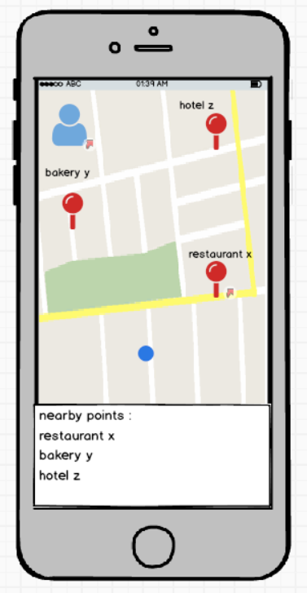
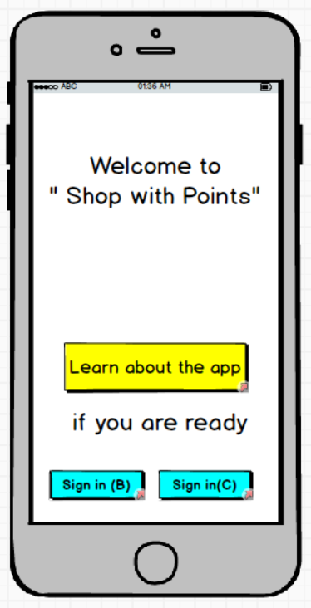
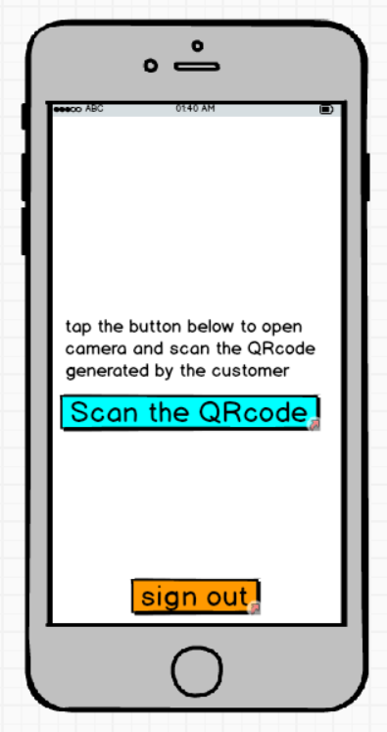
Wireframe by Balsamiq
Notes:
As the the initial step of our app development we put user stories that we intented to put in our very first version into balsamique userinterface mockups.. For example here after some tests and modifications, these are some final views for the app either for normal log in, in the middle, partner side, and on the left side we can a one of views in noral user side. The map view, with location of the restaurants, as well as their names on a table.

Slide 18
Docker
References
Technologies
UI and UX

Slide 19




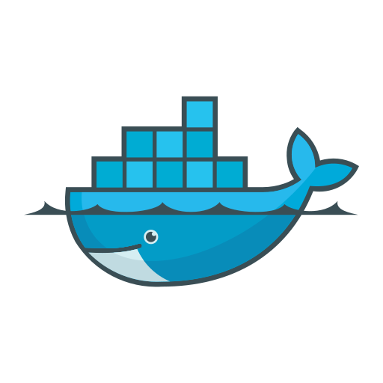



Technologies
Notes:
For the development of the idea, we decided to do the front end on swift and the backend on kotlin
We need for sure a database which mongodb is being used in this case, and for authentication and usermanagement service we used auth0, because we wanted to have user role association , which is possible with this service
We will use some crud operations by using Rest APIS and the back end is finally deployed on amazon webservices using labda, which is a serverless approach meaning that my code is not running on anyserver, but everytime that the app invokes an api call lamda starts our code returning response to user
At the end of lecture we will show the working app, but now i will show that the app is also is containerized using docker engine so you can see first what is inside incuding the apis and then the working app

Slide 20
Docker
References
Technologies
UI and UX

Slide 21
Docker

Slide 22
Docker
References
Technologies
Demo

Slide 23
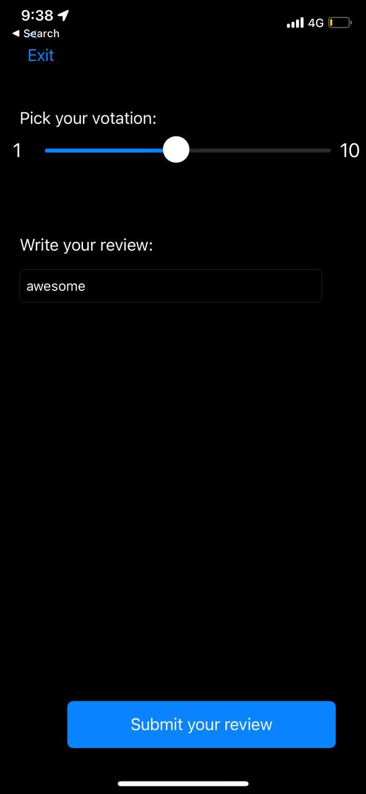
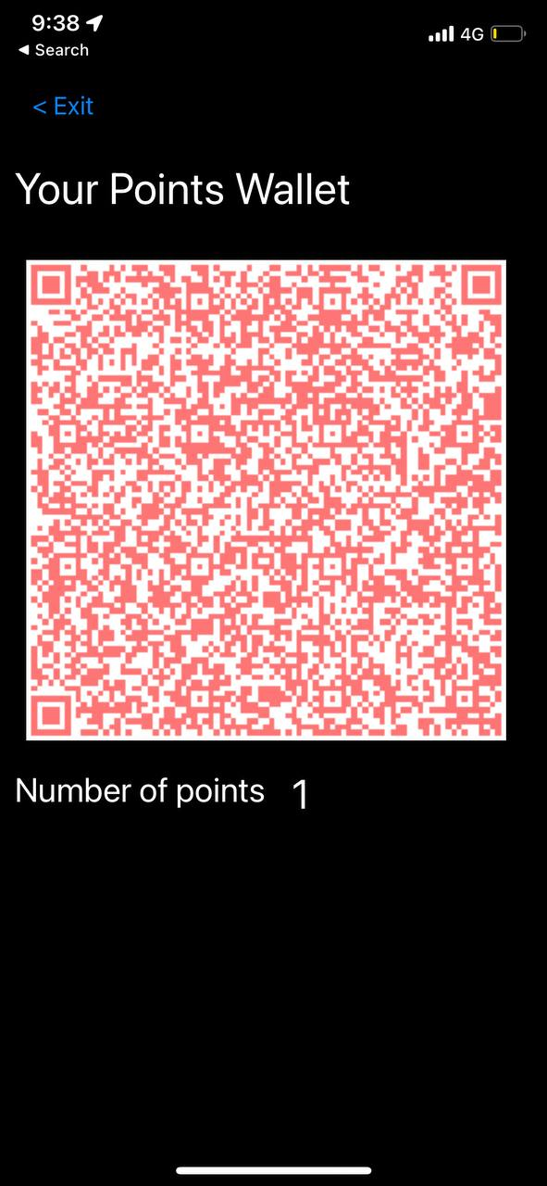
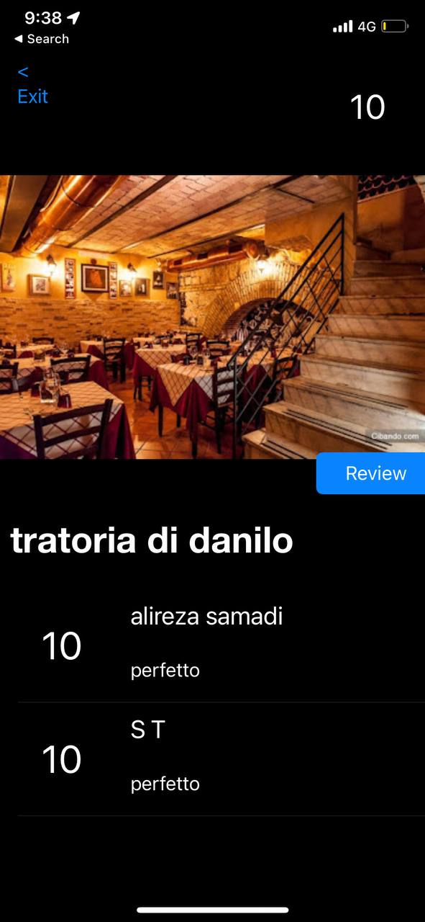
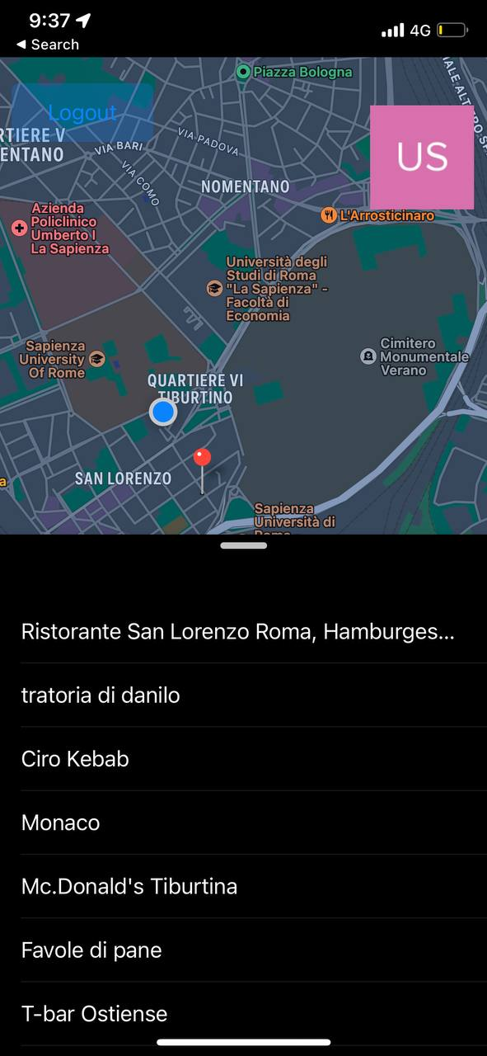
UI and UX (Demo)+Postman
Notes:
Ashkan

Slide 24
Docker
References
Technologies
Demo

Slide 25
References

Slide 26
Thanks

